Slide 1
Continuous RV
Ch-5 Sheldon Ross Book

Slide 2
Outline
Continuous Random Variables
Expectations, Variances
Joint Probability Distributions
Marginal Probability Distributions
Covariance
Bivariate Normal Distributions

Slide 3
Continuous Probability Distributions
A continuous random variable can take any numerical value within some interval.
A continuous distribution can be characterized by its probability density function.
For example: for an interval (a, b],
The function f (x) is called the probability density function of X. Every p.d.f. f (x) must satisfy

Slide 4
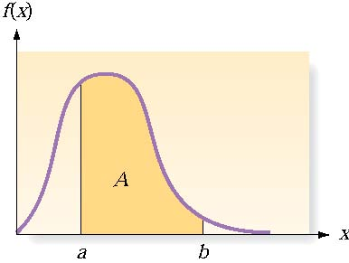
Continuous Probability Distributions
There are an infinite number of possible outcomes
P(x) = 0
Instead, find P(a<x≤b)
If a random variable X has a continuous distribution for which the p.d.f. is f(x), then the expectation E(X) and variance Var(X) are defined as follows:

Slide 5
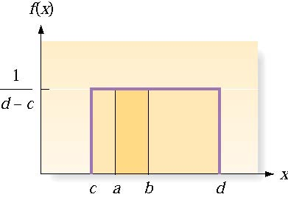
The Uniform Distribution on an Interval
For two values a and b
Mean and Variance

Slide 6
The Normal Distribution
The probability density function f(x):
µ = the mean of x,  = the standard deviation of x
Notes:
Closely approximates many situations
Perfectly symmetrical around its mean

Slide 7
Example 4: Say a toy car goes an average of 3,000 yards between recharges, with a standard deviation of 50 yards (i.e., µ = 3,000 and  = 50) .
What is the probability that the car will go more than 3,100 yards without recharging?

Slide 8
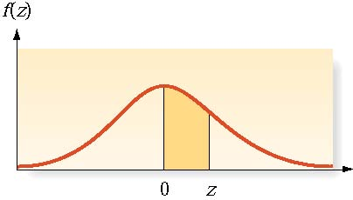
The Normal Distribution (Cont.)
Notes:
Closely approximates many situations
Perfectly symmetrical around its mean

Slide 9
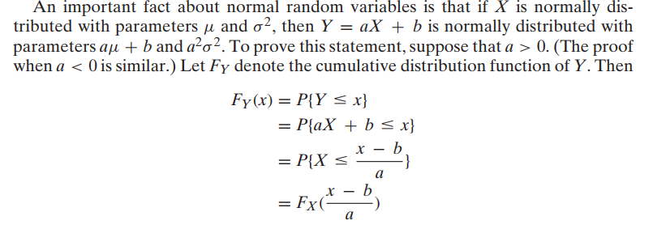

Slide 10
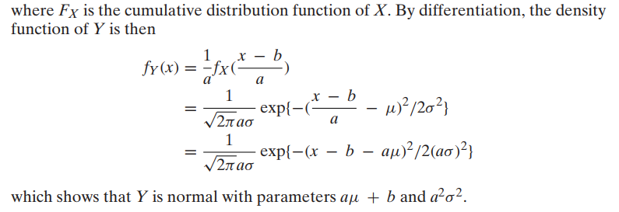

Slide 11
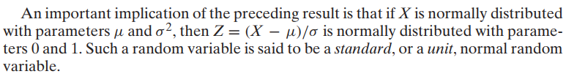
Standard Normal RV

Slide 12
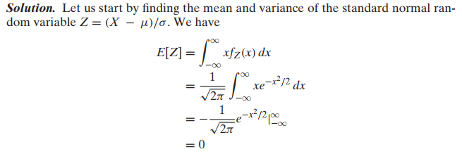
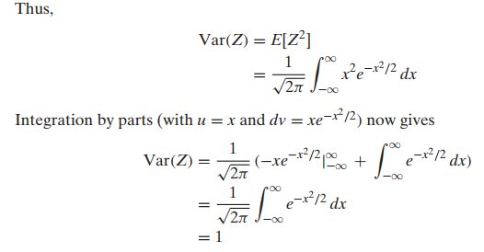

Slide 13

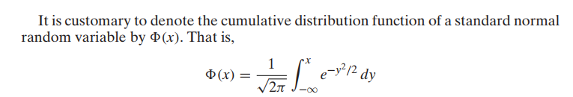


Slide 14
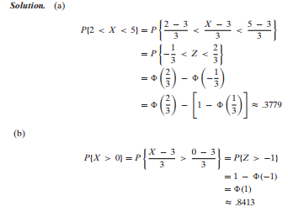

Slide 15
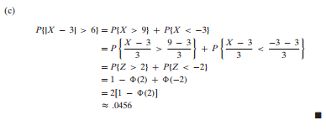

Slide 16
The Exponential Distribution
Probability Distribution for an Exponential Random Variable x
Probability Density Function
Mean: Variance:

Slide 17
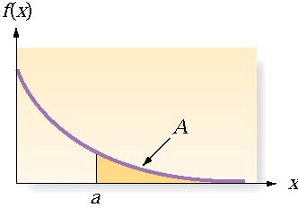
The Exponential Distribution (Example 5)
Example 5: Suppose the waiting time to see the nurse at the student health center is distributed exponentially with a mean of 45 minutes. What is the probability that a student will wait more than an hour to get his or her generic pill?

Slide 18
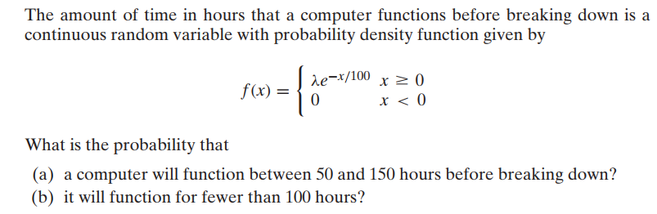

Slide 19
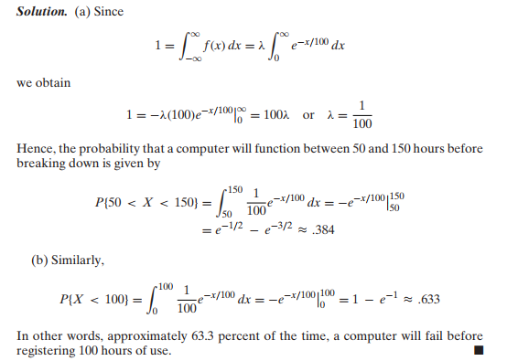

Slide 20


Memoryless Property of Exponential RV
If we think of X as being the lifetime of some instrument
Find that the probability that the instrument survives for at least s + t hours, given that it has survived t hours?
is the same as the initial probability that it survives for at least s hours.

Slide 21
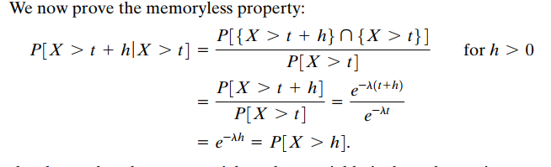
It can be shown that the exponential random variable is the only continuous random variable that satisfies the memoryless property.

Slide 22
Mathematical Expectation
Mathematical Expectation-I: Expectation of a Continuous Function of a Single Random Variable. Properties: Mean, Variance, SD, Moments, Skewness, & Kurtosis of a Distribution Moment Generating Function, Characteristic Function; Median, Quartiles and Mode.

Slide 23
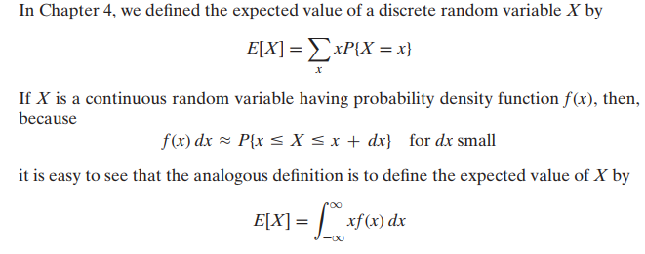
Mean of a function of RV

Slide 24
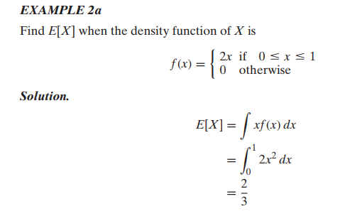
Ex-1

Slide 25
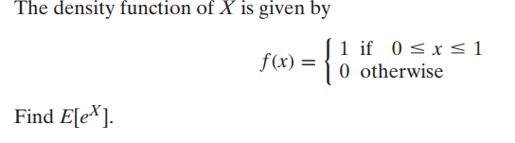
Ex-2
Find CDF and PDF of Y=exp(X)
Then compute E[Y]

Slide 26
